Slide 1
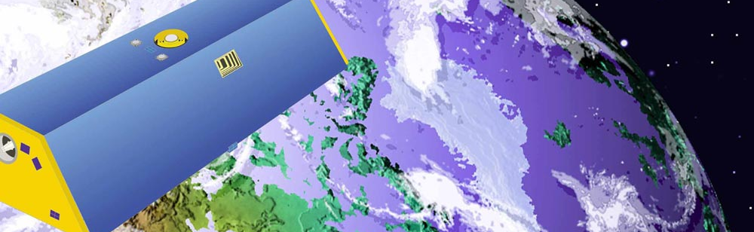



Improved methods for observing Earth’s time variable mass distribution with GRACE using spherical cap mascons
Ka Hei Pinky, Chow
Michael M. Watkins, David N. Wiese, Dah-Ning Yuan, Carmen Boening, and Felix W. Landerer

Slide 2
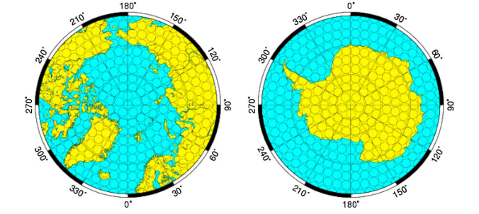
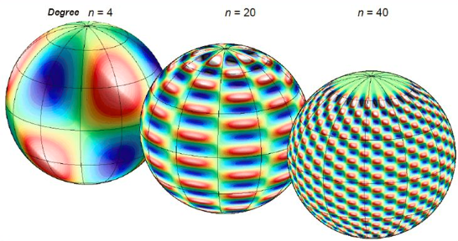
Summary
Mascon solution
Comparison between mascon solution, spherical harmonic solution, and in situ data
Agreement between two solutions
Reduce leakage error, increase resolution, and minimized post-processing with scale factor
Better performance for land-ocean boundary and low latitude ocean
(Watkins, M. M., Wiese, D. N., Yuan, D. N., Boening, C., & Landerer, F. W., 2015).

Slide 3
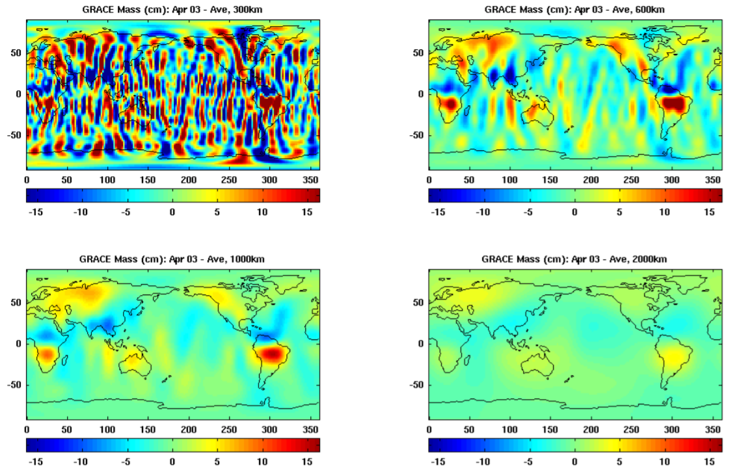
Residual aliasing effects:
Challenges to be solved
(Chen, J, 2019)

Slide 4
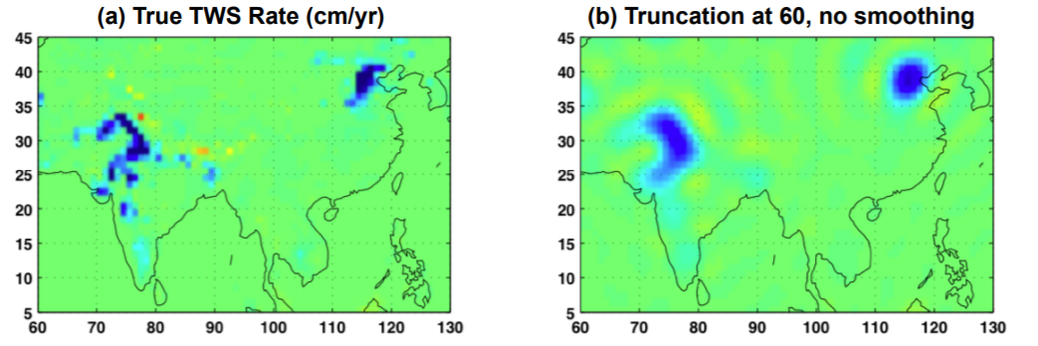
Leaking Error: Challenges to be solved
(Chen, J., 2019)

Slide 5
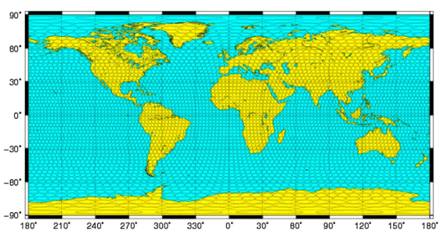
mascon solution JPL RL05M
Mass Concentration blocks
4551 equal-area, 3 arc-degree mascon cells
localized signals are averaged
Calculate gravitational potential in local mascon coordinate system
Geophysically based a-priori information
(Watkins, M. M. et. al., 2015)

Slide 6
Mascon v.s. spherical harmonics
(Scanlon, B. R. et. al., 2016)
Mascon | Spherical harmonics
Mass concentration functions | global spherical harmonics (SH) basis functions
Global to regional scale | Global scale
Enhanced resolution | Limited resolution
A priori constraints | Empirical post-processing filtering Noise reduction Signal restoration
Coastline Resolution Improvement (CRI) filter | Cannot distinguish land and ocean areas

Slide 7
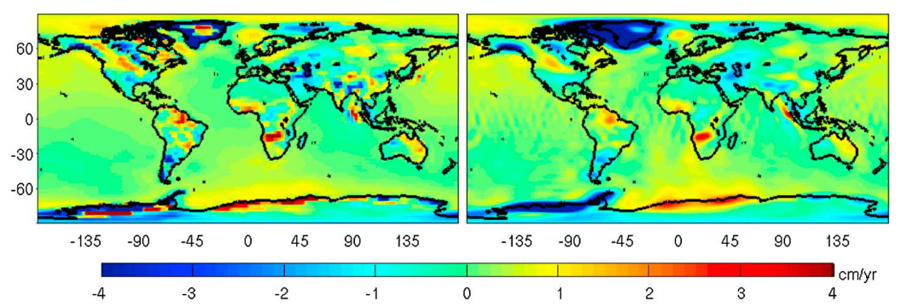
Comparison
The 2003–2013 trend for (left) JPL RL05M mascons and (right) JPL RL05 harmonics DS300 expressed in cm/yr and centimeter of EWH, respectively (Watkins, M. M. et. al., 2015)

Slide 8
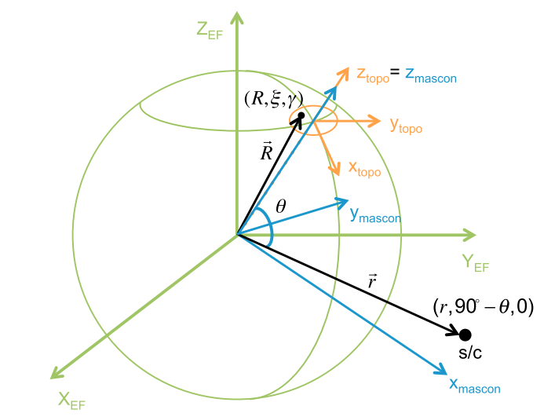
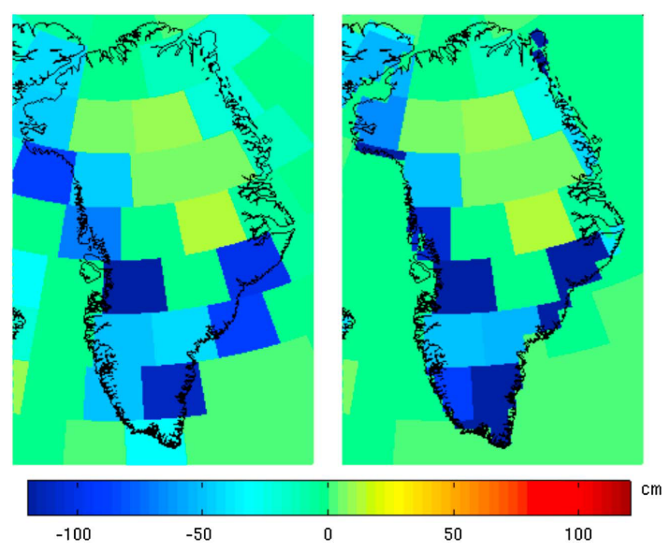
Understandings
Limitations of Spherical harmonics
The post-processing steps of SH
Alternative solution
Algorithm to resolve leaking error
Comparison
(Watkins, M. M. et. al., 2015)

Slide 9
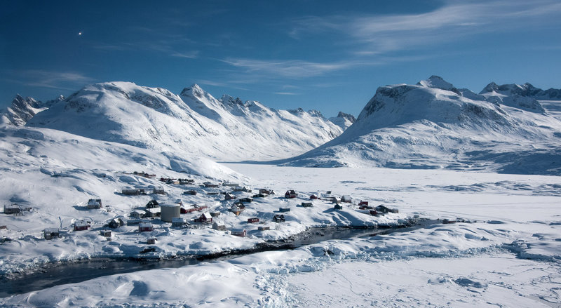
To be Understood
Types of mascon solutions
Local mascon coordinate system and
final inertial system
K-band microwave ranging bias
A priori spatial correlation

Slide 10
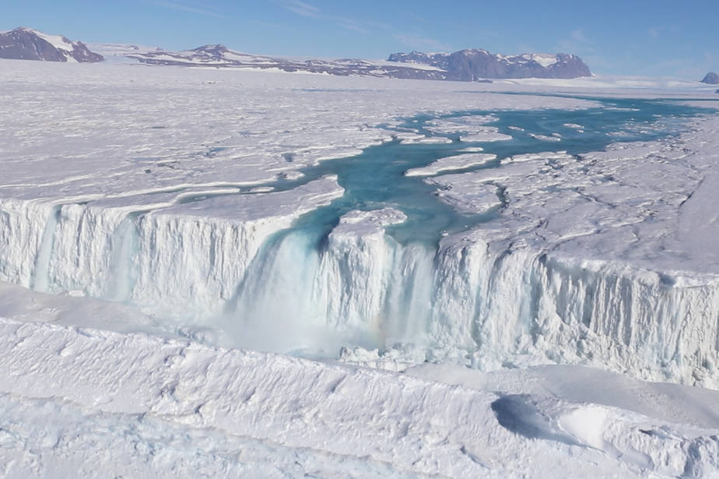
Well-done and poorly done

Slide 11
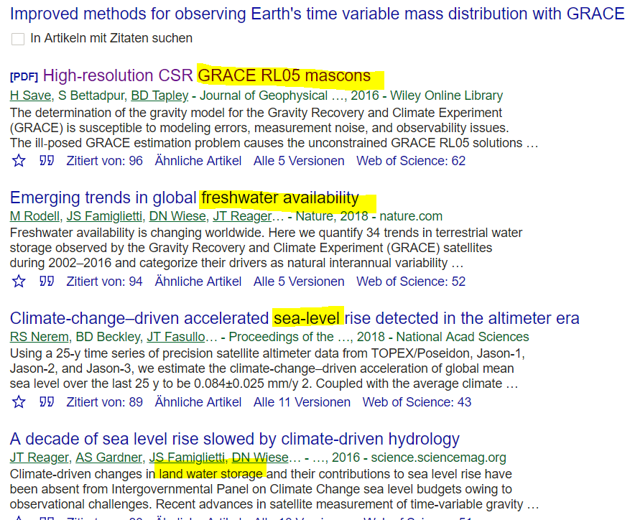
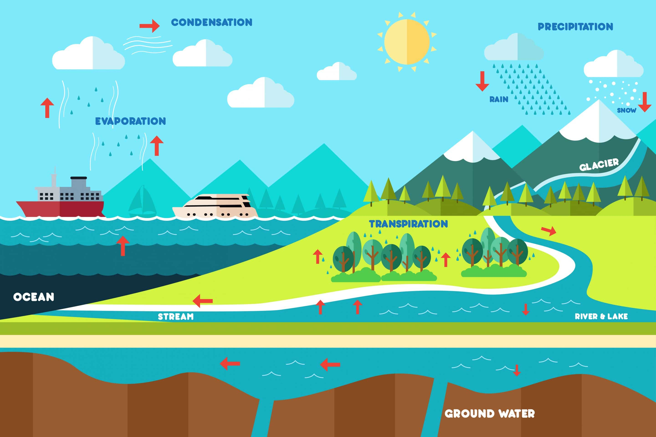
Impacts on scientific community

Slide 12
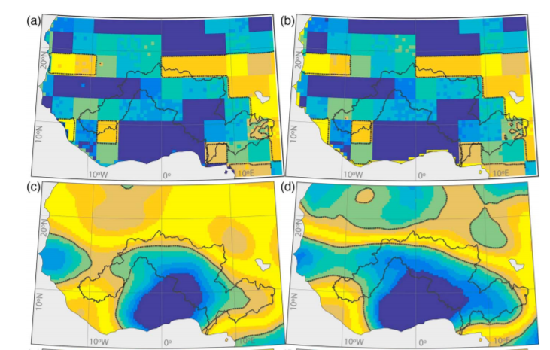
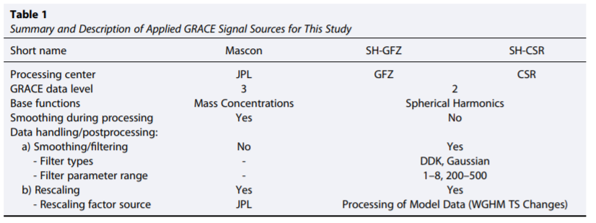
Case 1: Niger River basin
(Werth, S., White, D., & Bliss, D. W., 2017)

Slide 13
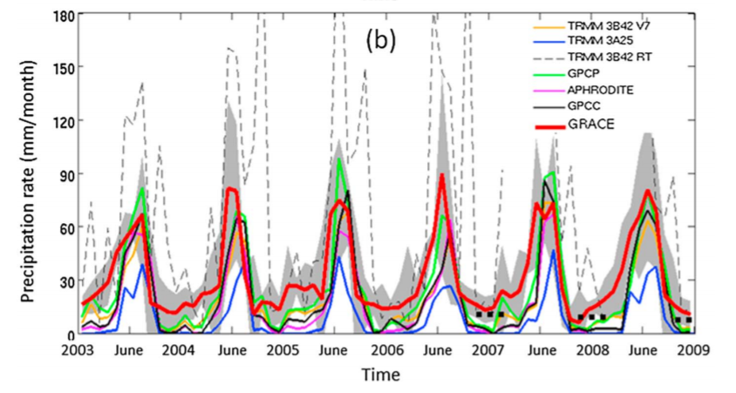
Case 2: western Tibetan Plateau
(Behrangi, A., Gardner, A. S., Reager, J. T., & Fisher, J. B., 2017)

Slide 14
References
Behrangi, A., Gardner, A. S., Reager, J. T., & Fisher, J. B. (2017). Using GRACE to constrain precipitation amount over cold mountainous basins. Geophysical Research Letters, 44(1), 219-227.
Chen, J. (2019, April 10). Challenges of GRACE Data Processing. Lecture, Austin.
Watkins, M. M., Wiese, D. N., Yuan, D. N., Boening, C., & Landerer, F. W. (2015). Improved methods for observing Earth's time variable mass distribution with GRACE using spherical cap mascons. Journal of Geophysical Research: Solid Earth, 120(4), 2648-2671.
Werth, S., White, D., & Bliss, D. W. (2017). GRACE detected rise of groundwater in the Sahelian Niger River basin. Journal of Geophysical Research: Solid Earth, 122(12).
Scanlon, B. R., Zhang, Z., Save, H., Wiese, D. N., Landerer, F. W., Long, D., ... & Chen, J. (2016). Global evaluation of new GRACE mascon products for hydrologic applications. Water Resources Research, 52(12), 9412-9429.

